Slide 1
DB25 Relay Circuit Baord

Slide 2
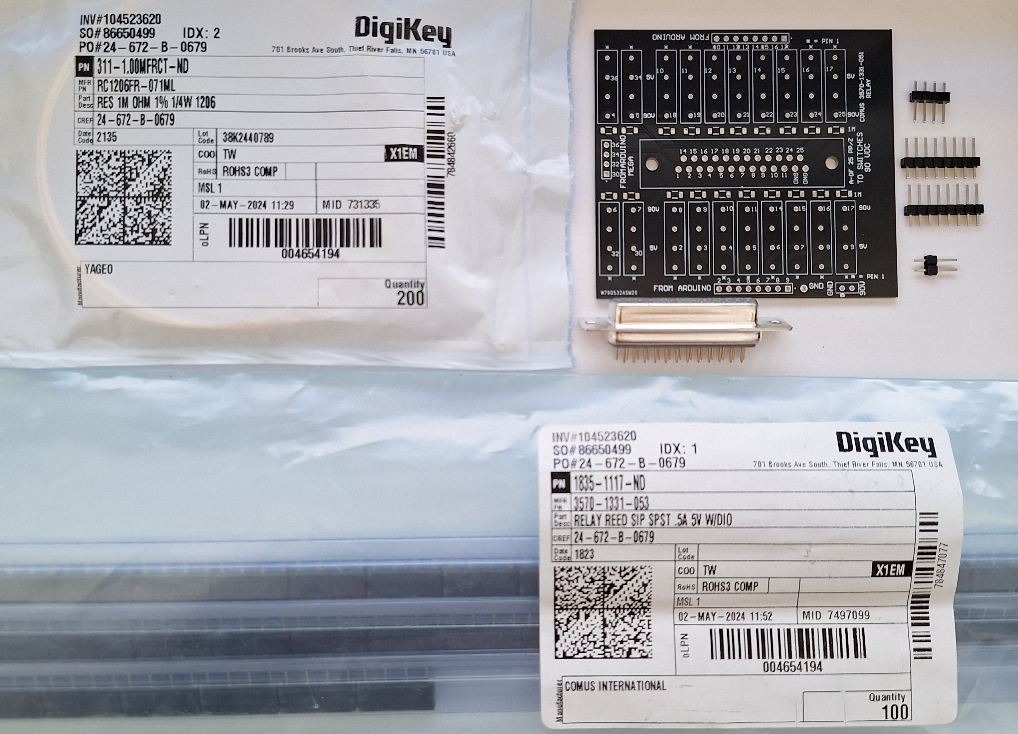
Kit

Slide 3
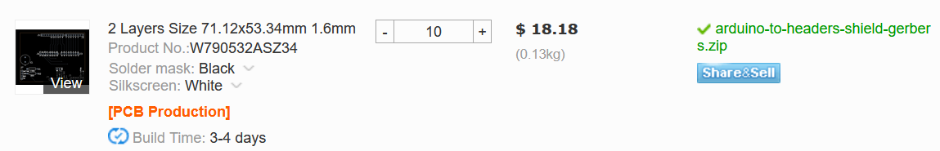
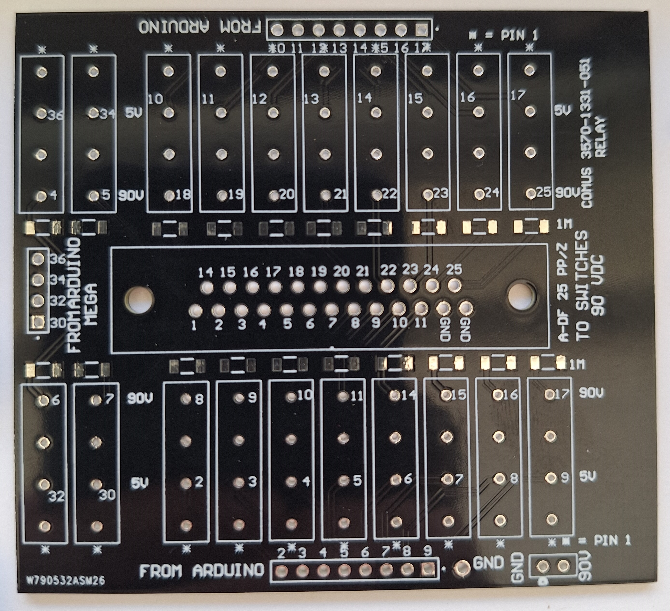
78.74 x 71.12 mm
(3.1 x 2.8 in) size
Black solder mask
White silkscreen
1.6mm FR4
https://github.com/lafefspietz/MEMSduino/raw/main/PCB_files/DB25-relay-HV-control-gerbers.zip
MEMSDuino

Slide 4
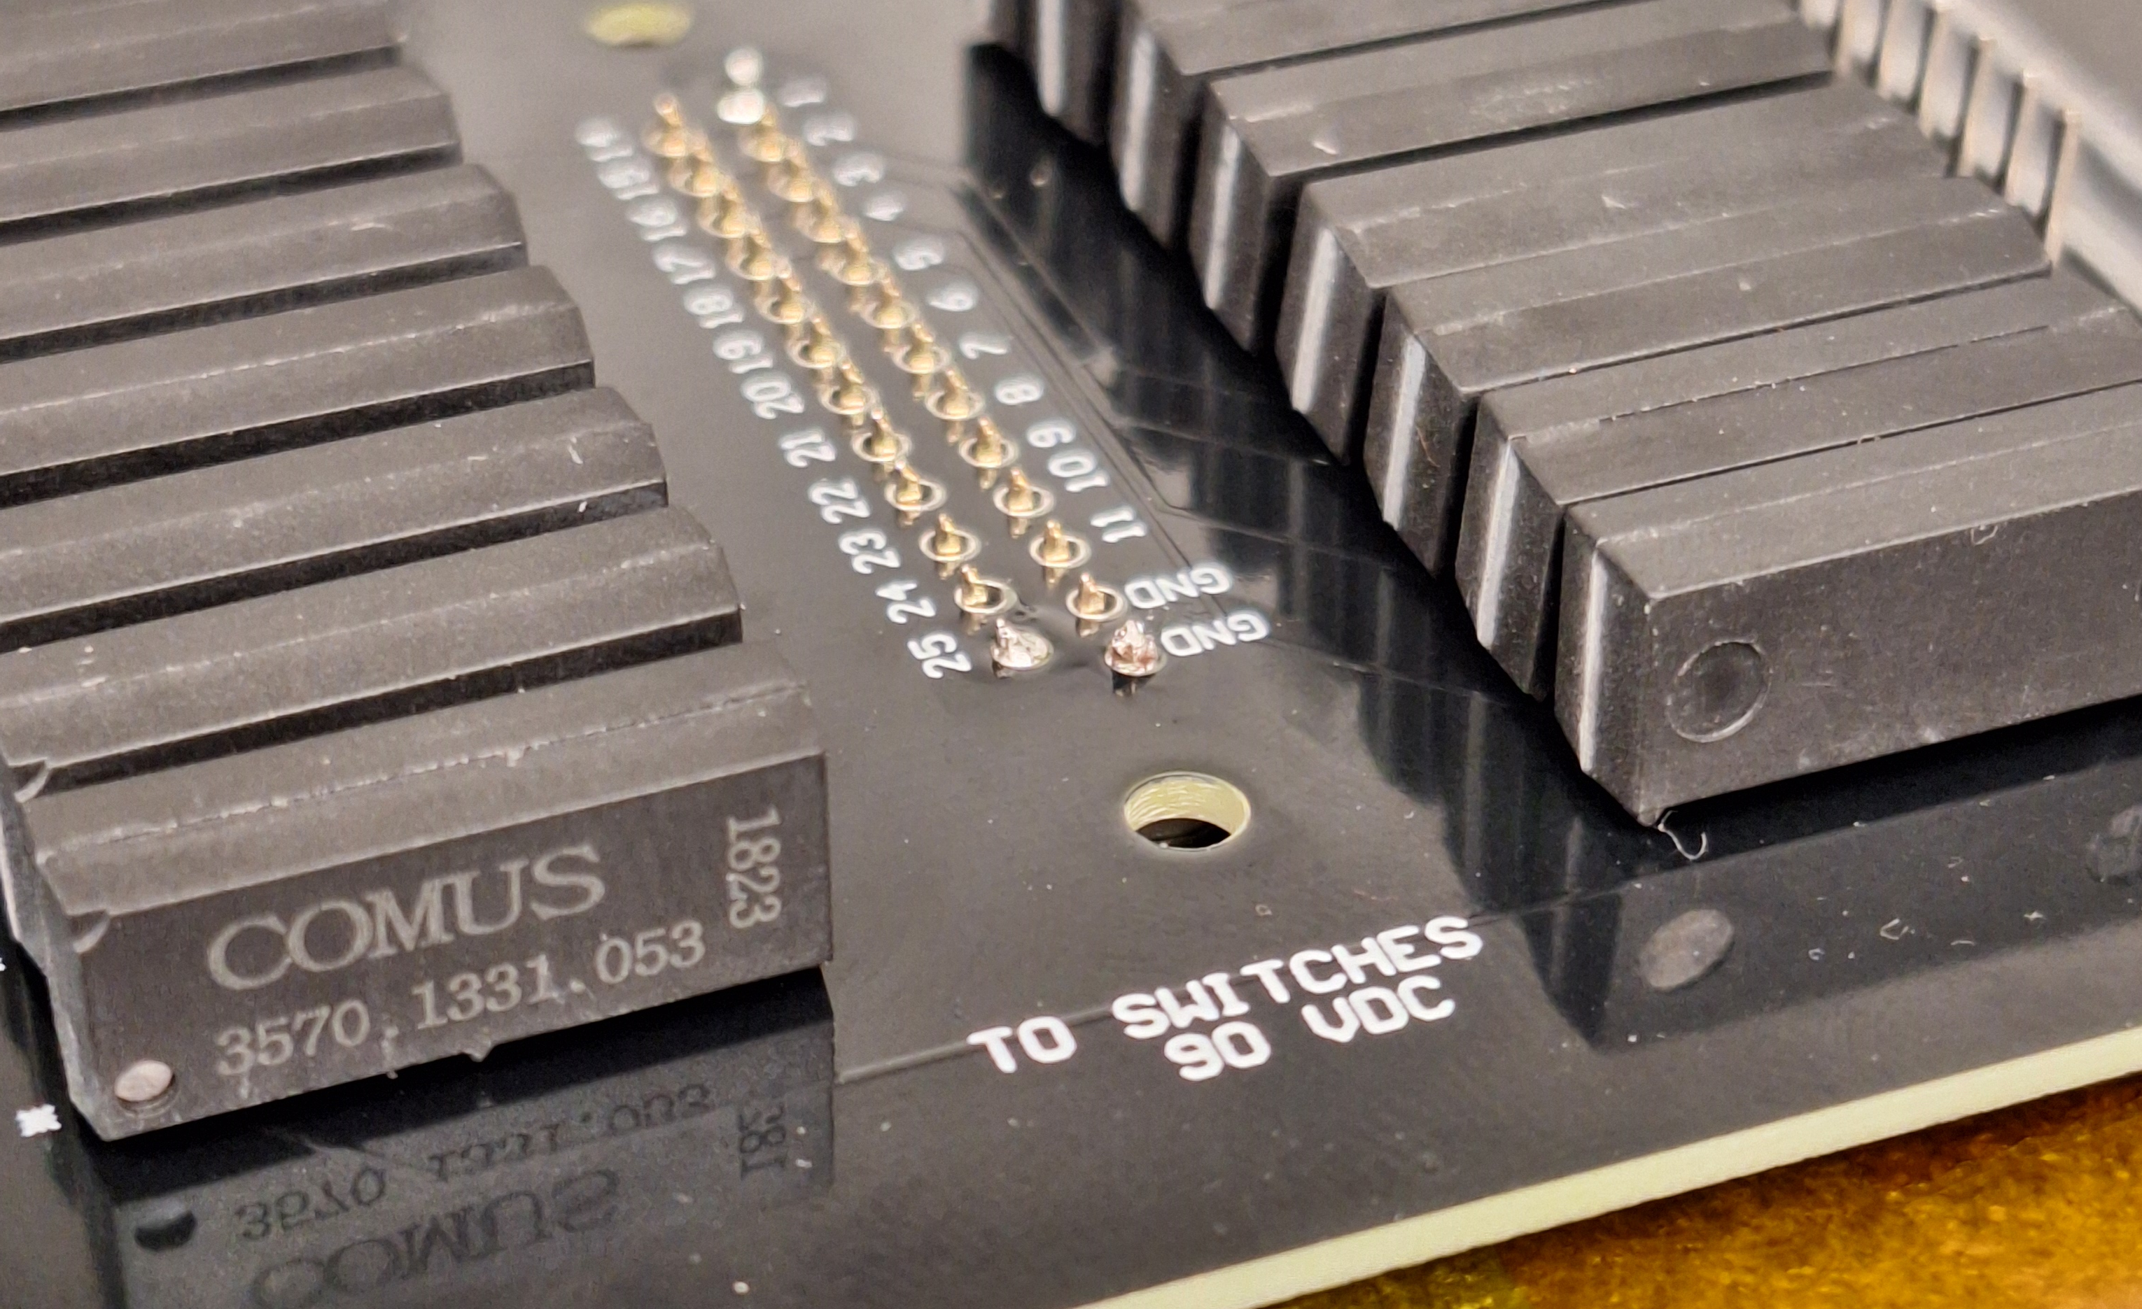
Lift board up when soldering to increase clearance
MEMSDuino

Slide 5
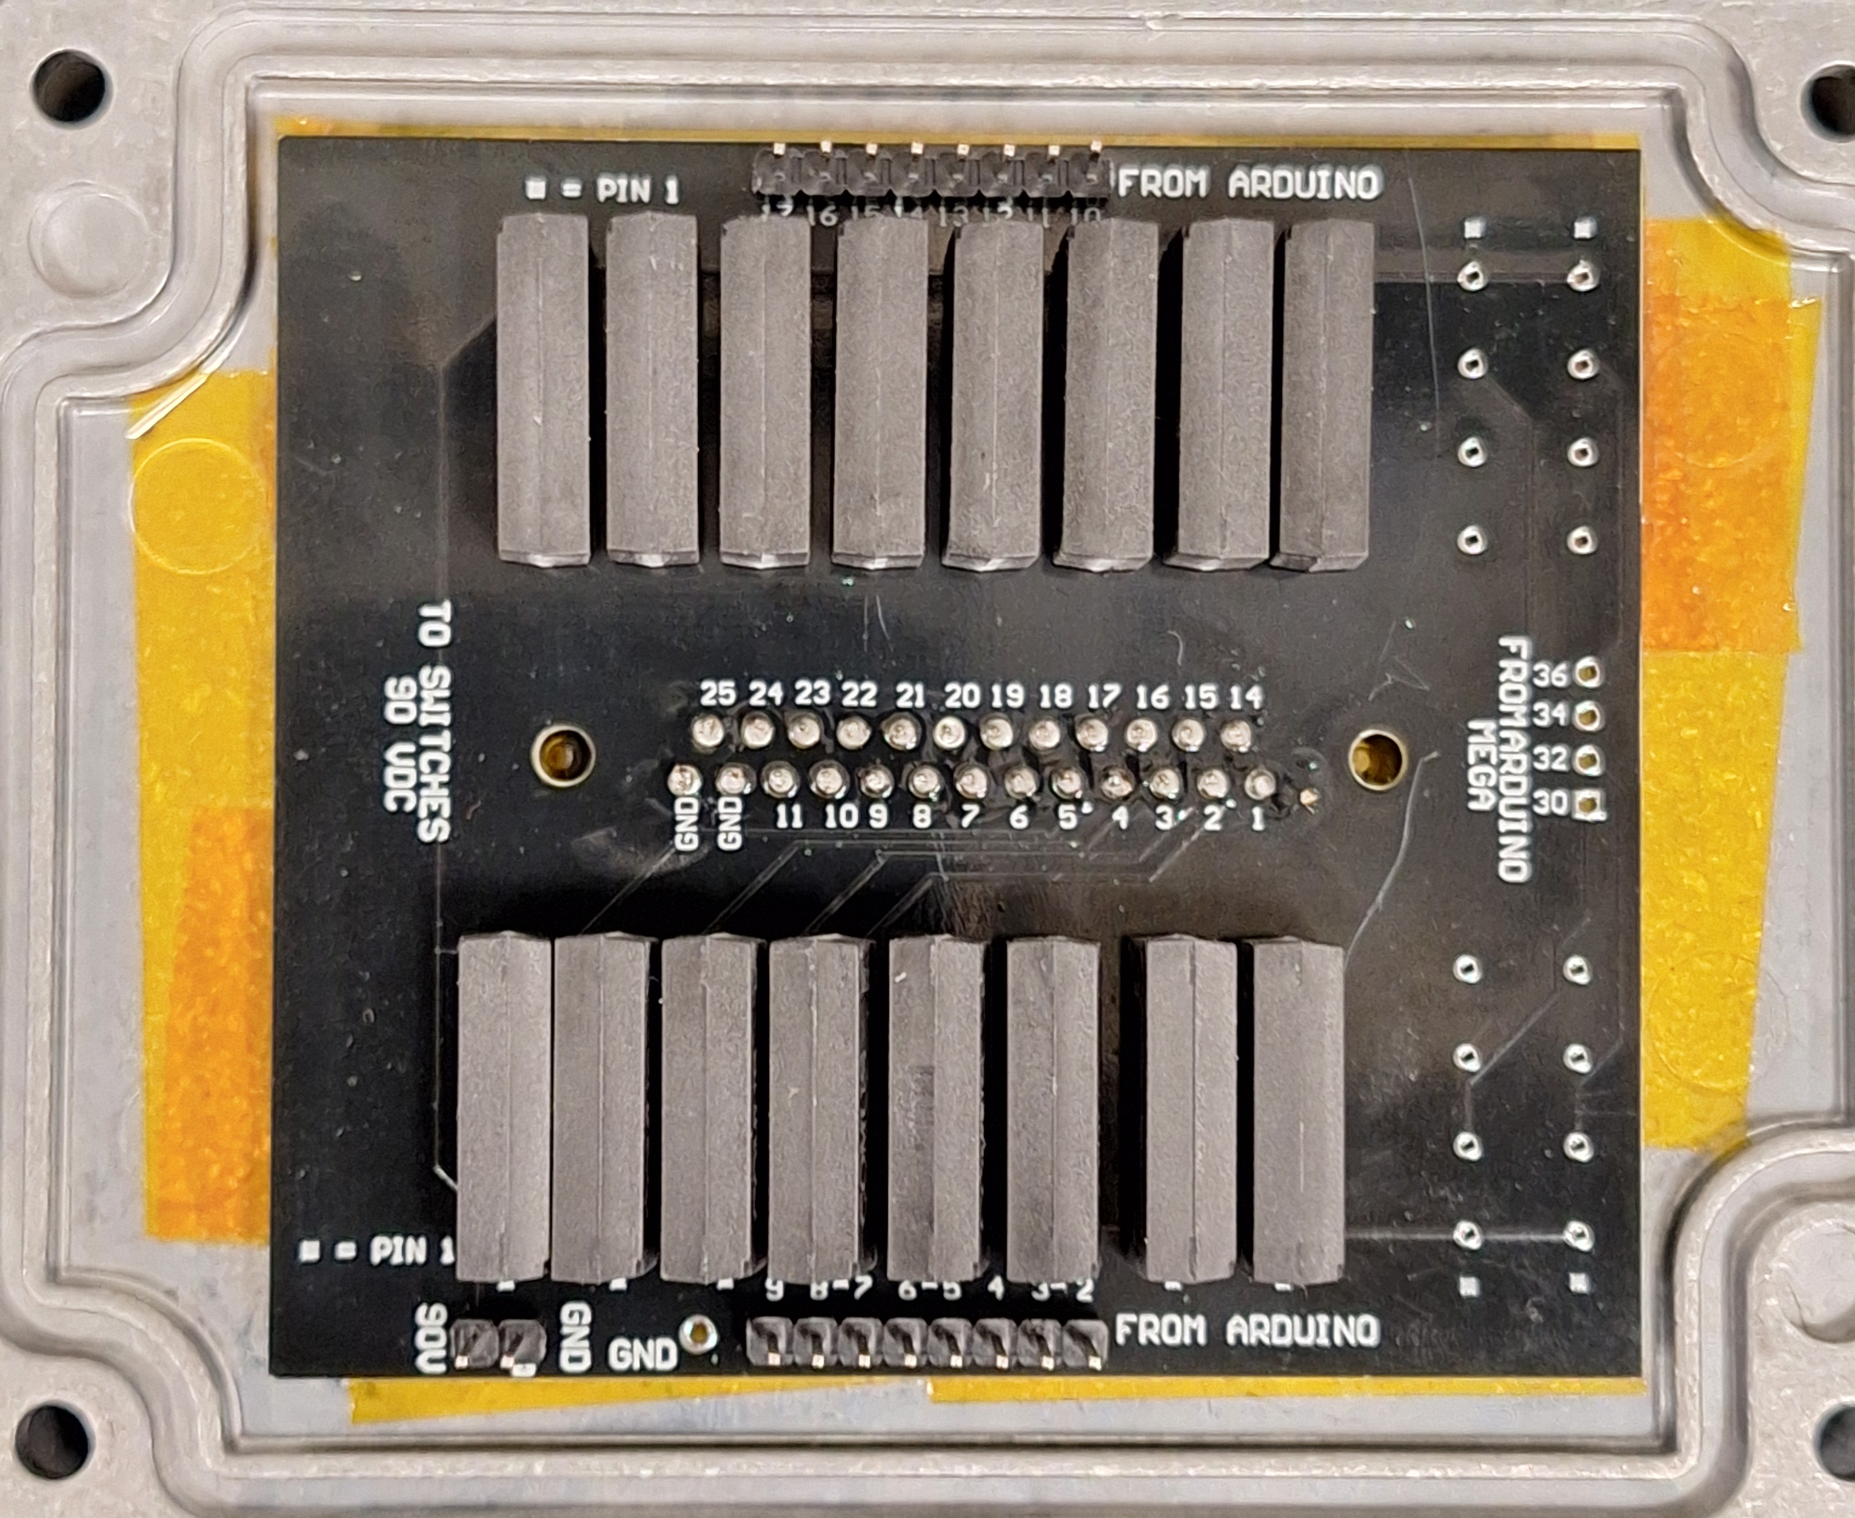
Assembly
MEMSDuino

Slide 6
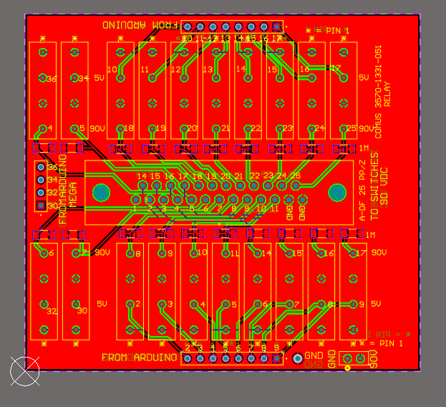
MEMSDuino

Slide 7
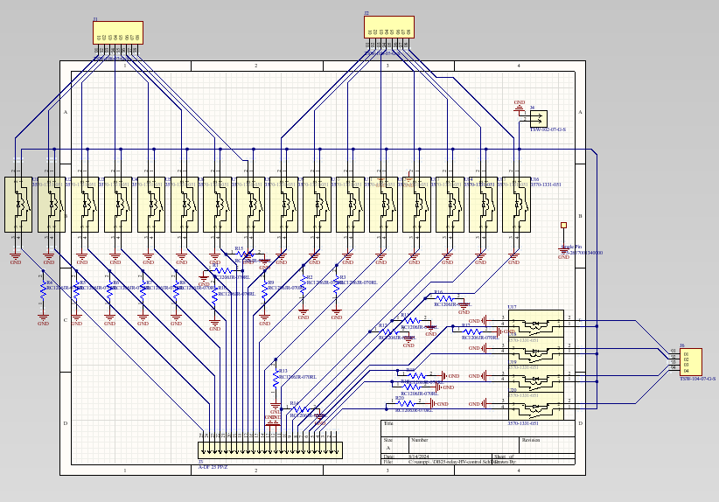
MEMSDuino

Slide 8
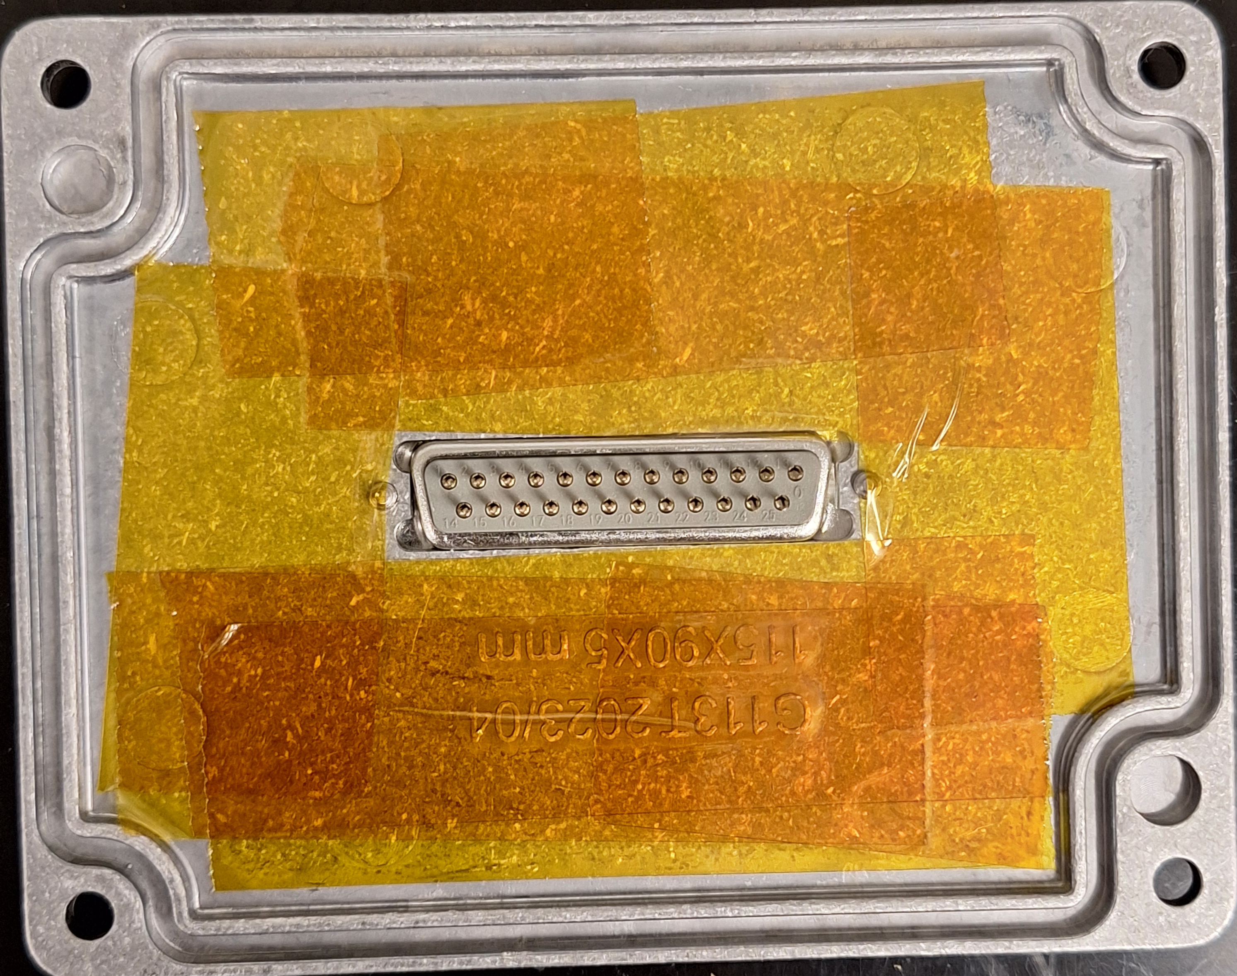
Adding polyimide tape to the lid
This must be assembled before the circuit board is soldered to the DB25 connector!
Prevent potential shorts
MEMSDuino

Slide 9
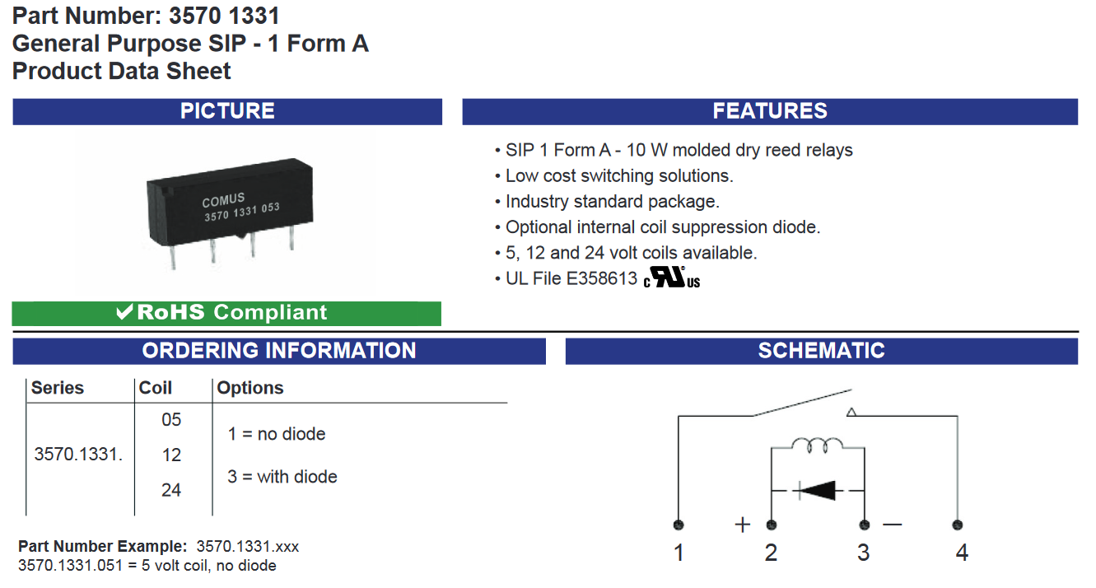
Relay
https://www.digikey.com/en/products/detail/comus-international/3570-1331-053/7497099
MEMSDuino

